Slide 1
Lowell High School Occasional Series on Contemporary Issues
What Drives Education
in the 21st Century?

Slide 2
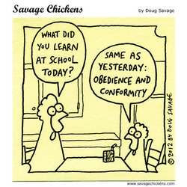
Where we came from…

Slide 3
Progress?

Slide 4
Schools today are driven to…
Prepare students for the workforce of tomorrow…
but how do we know what skills that workforce will demand when those jobs don’t exist yet?
2. Prepare students for a global economy/ world…
but do we understand the full ramifications of this – competition, cultural norms, language, etc?
3. Prepare students to be fully engaged citizens…
who are equipped with the skills to handle the problems we are unknowingly creating for the future, changing citizenry

Slide 5
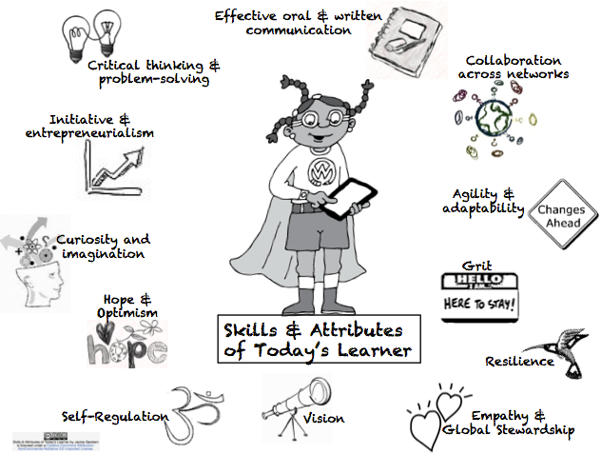

Slide 6
Technology & Education
“I think we need to have technology like oxygen—ubiquitous, necessary, and invisible. It’s got to be everywhere. It’s got to be part of everything you do. And then you’ve got to stop talking about it so much. Kids aren’t doing a technology project every time they pull out a laptop or a phone. It’s time to understand that this stuff is the way we work today.”
(Chris Lehmann, Founding Principal, Science Leadership Academy)

Slide 7
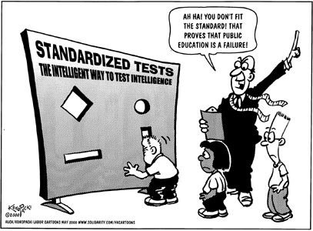
And what about the test…

